Slide 1
Open Targets resources for drug target identification and prioritisation
CRUK-AZ antibody alliance
Granta Park
January 14th 2020
Denise Carvalho-Silva
Open Targets | EMBL-EBI
Wellcome Genome Campus
United Kingdom

Slide 2
This session 13:00-17:00
Introduction to Open Targets
Open Targets Platform: talk + live demo
Hands-on exercises
Open Targets Genetics and wrap up

Slide 3
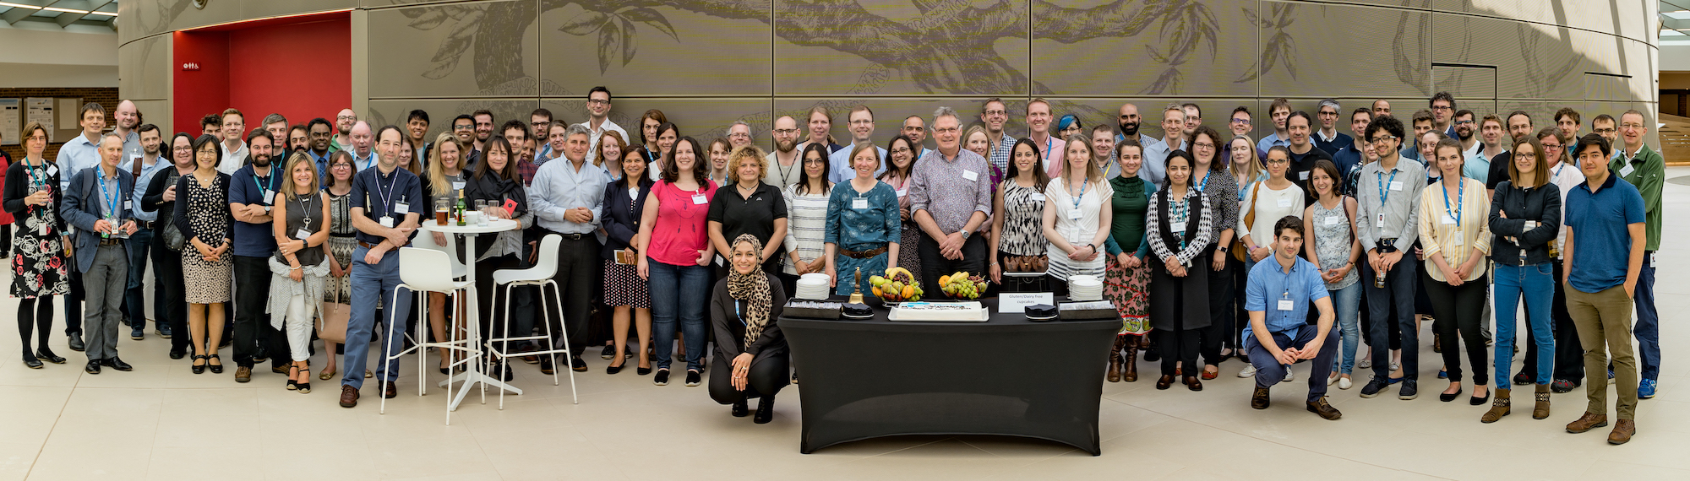







Acknowledgements

Slide 4
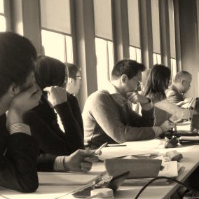
What will I get out of this session?
Open Targets?
What is it?
What data and resources does it provide?
How can I make the most
of these resources?
How to get in touch
with the team?

Slide 5
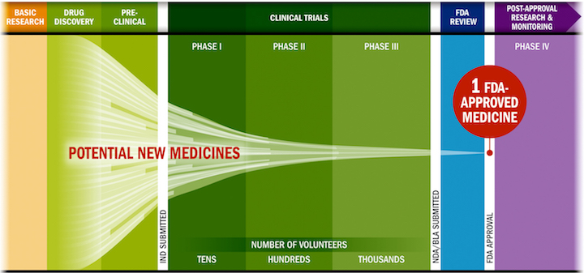
Drug discovery: some challenges
Lengthy, costly, low success rate, HIGH ATTRITION RATES
Source: PhRMA adaptation based on Tufts CSDD & School of Medicine, and FDA
Notes:
PhRMA (
Lengthy: Drug discovery from start (idea) to finish (market) can take up to 20 years.
Costly: specially from clinical trials when human subjects are tested (volunteers or suffering from the condition)
Compounds drop out along the drug discovery journey → low success, high attrition

Slide 6
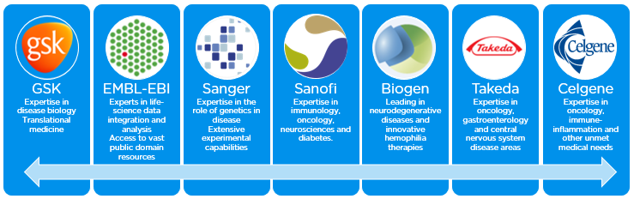
Open Targets
A partnership to transform drug discovery
Founding partners
2018
2016
2017
2018
Systematic identification and prioritisation of targets

Slide 7
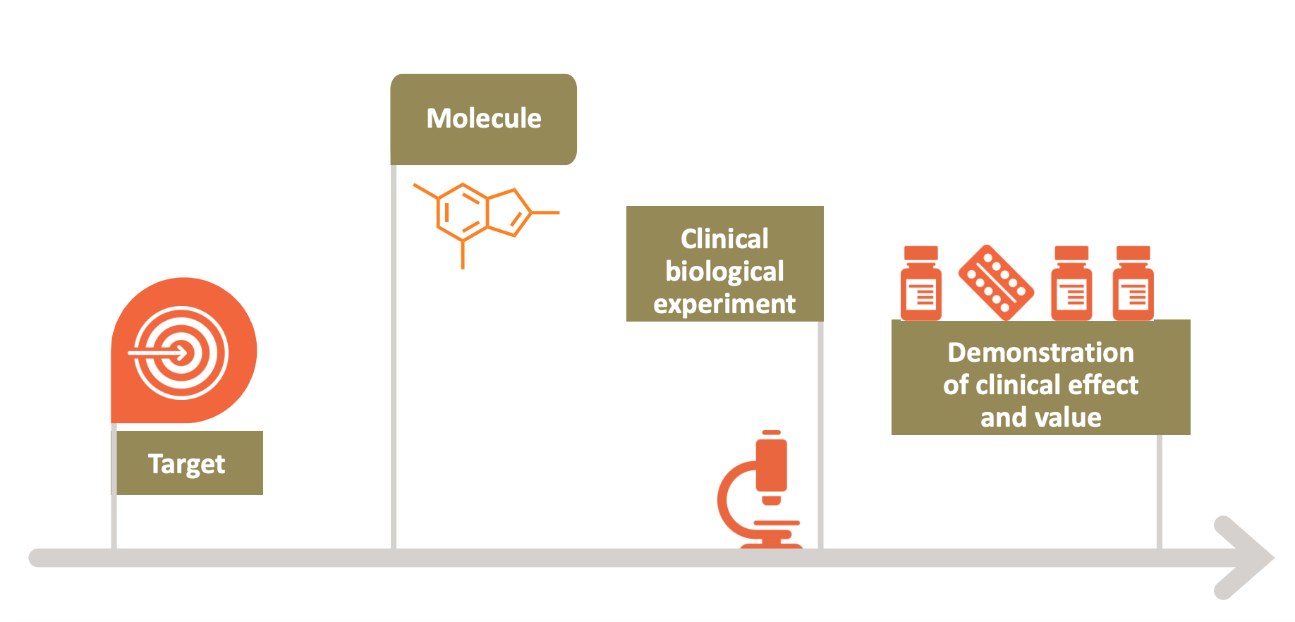
Selecting the right target
Drugs that fail are neither safe nor efficacious

Slide 8









Knowledge cycle
Public data
Experimental projects
Bioinformatics projects
DATA
GENERATION
DATA
INTEGRATION
Therapeutic hypothesis

Slide 9
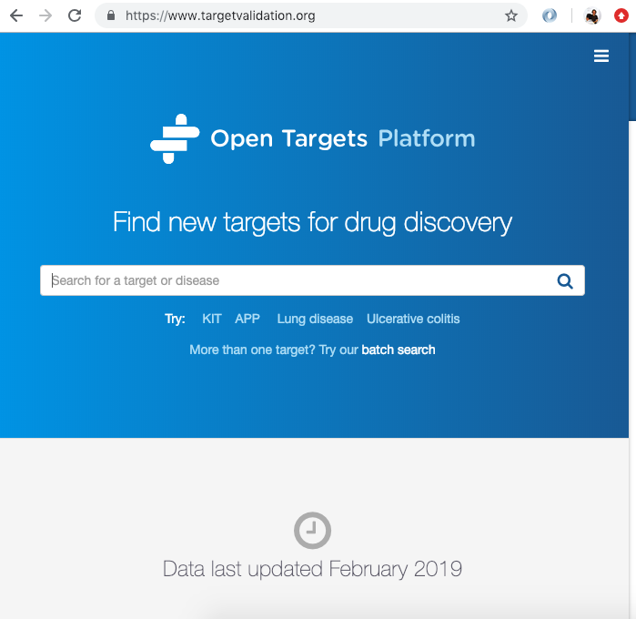
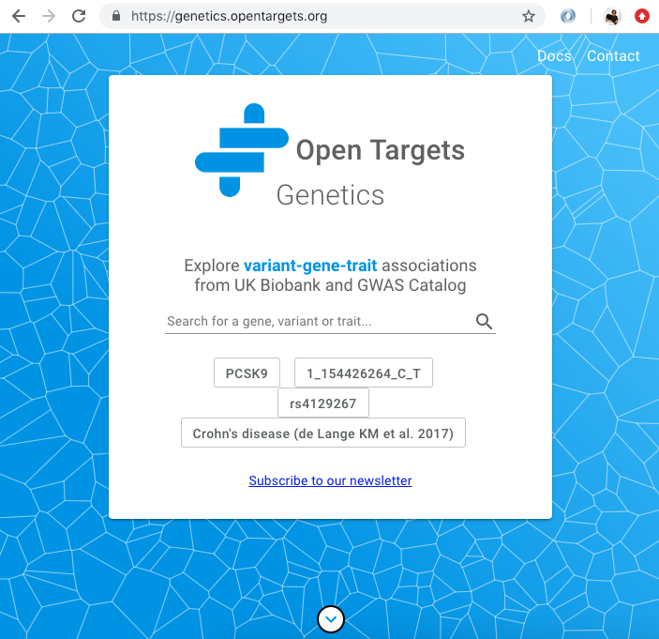
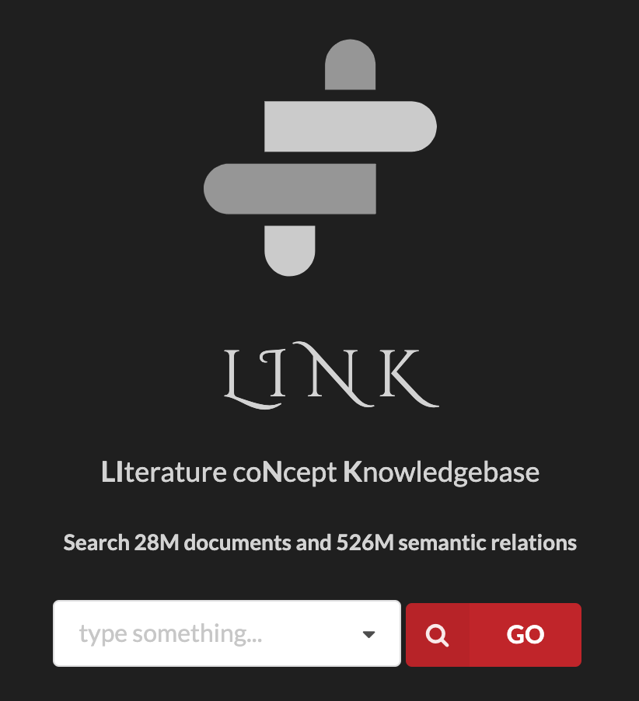
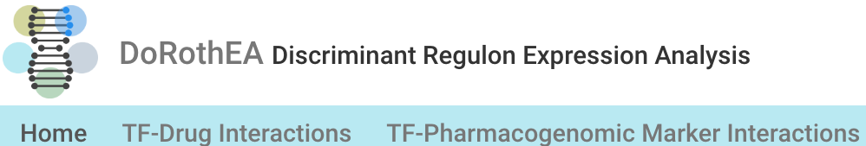
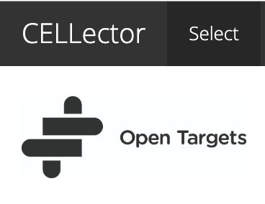
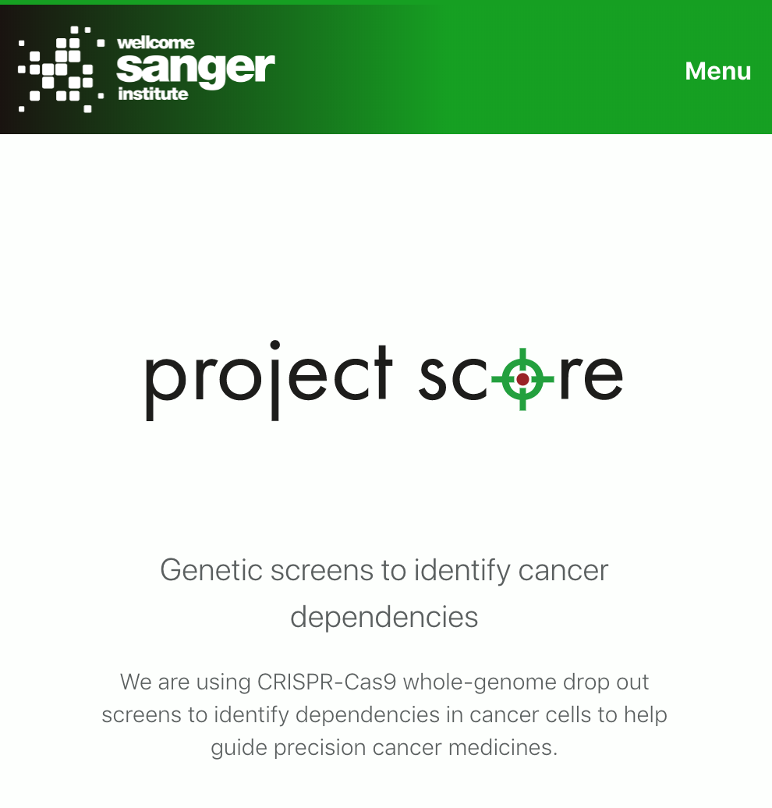
Data integration: web resources
Data integration: Open Targets
https://www.opentargets.org/resources/#open-targets-platform

Slide 10
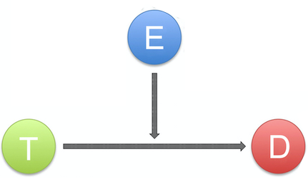
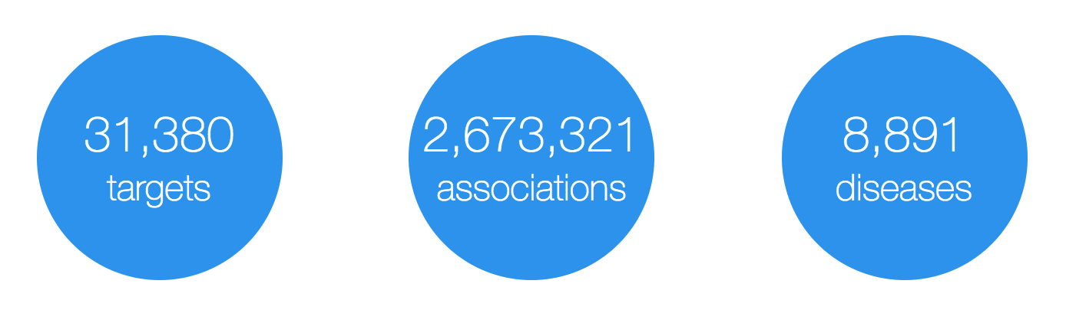
Open Targets Platform: data model
Evidence
(variants, drugs, literature, etc)
Target
(protein and non-protein coding genes)
Disease
(rare and common)
https://www.targetvalidation.org

Slide 11
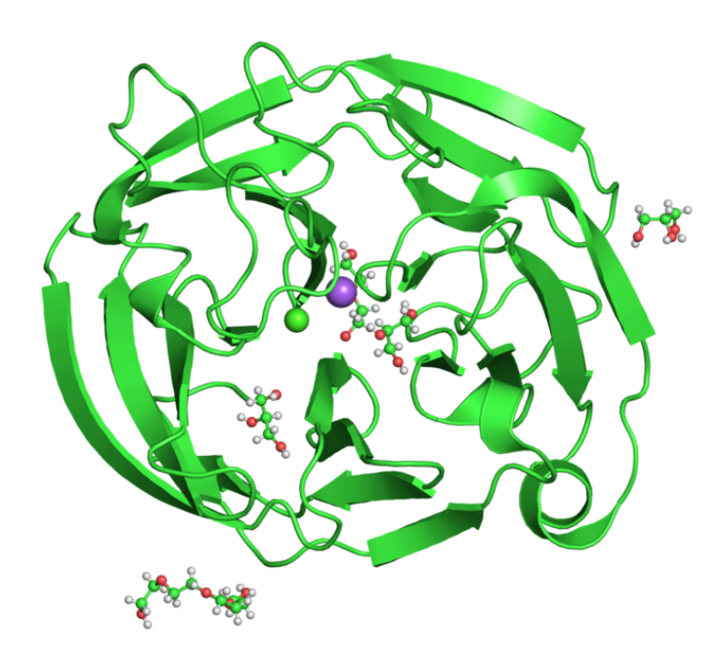
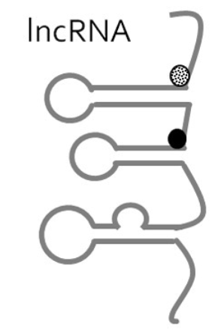
What is a target?
MYOC - glaucoma
(PDBe 4wxs)
Xist – Turner syndrome
(lncRNA)
27,069

Slide 12
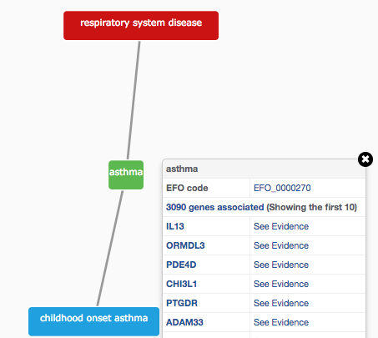
How do we describe our diseases?
Modified version of Experimental Factor Ontology v3 (EFO3)
Controlled vocabulary (Coeliac versus Celiac)
Hierarchy (relationships)
Promotes consistency
Increases the richness of annotation
Allow for easier and automatic integration
13,579

Slide 13
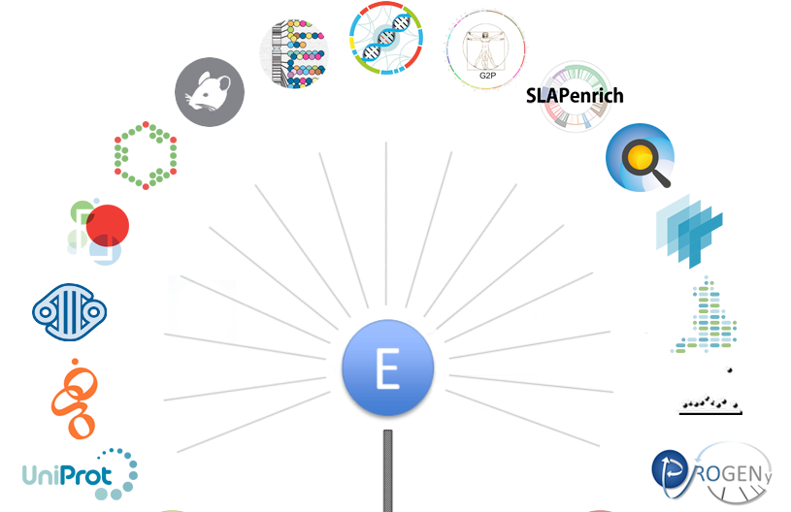
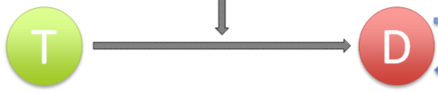
Evidence for target-disease associations
8,919,232
https://docs.targetvalidation.org/data-sources/data-sources

Slide 14
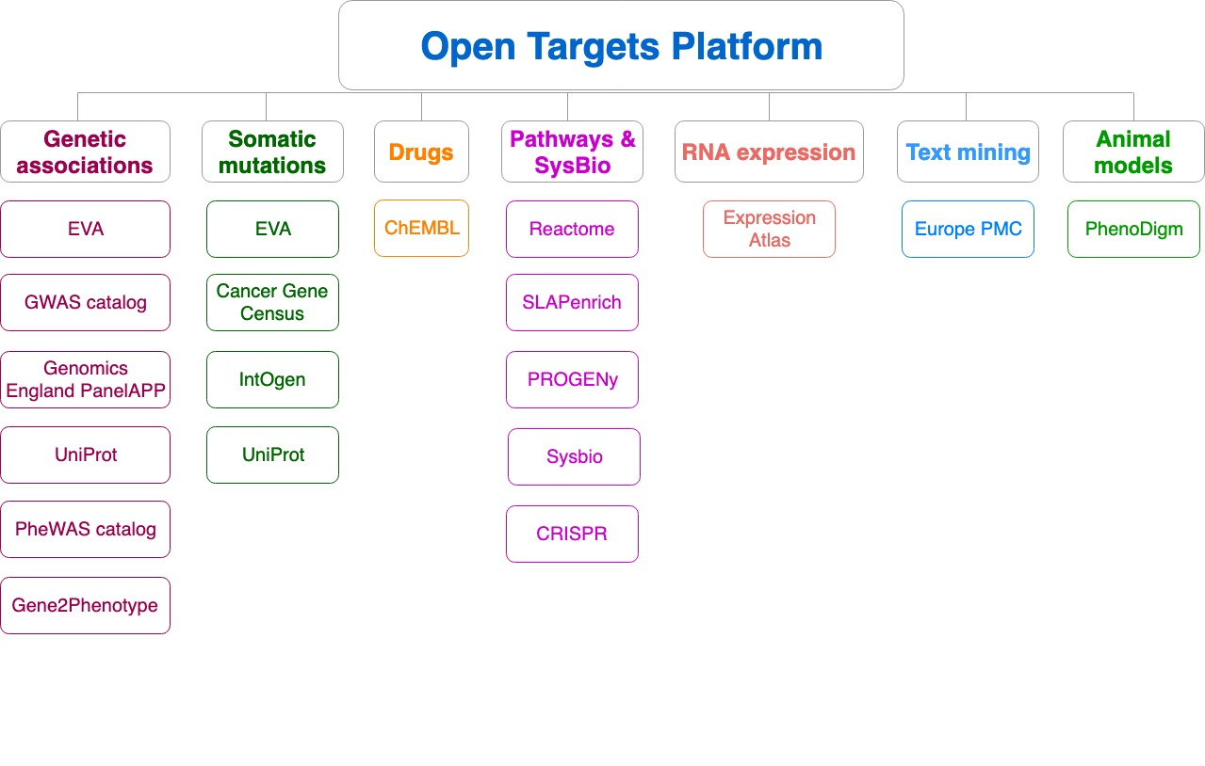
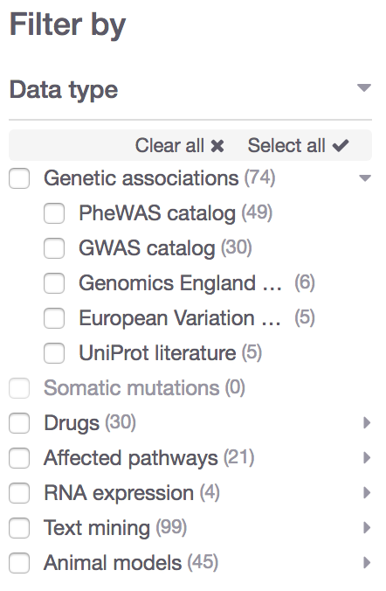
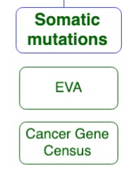
Data sources grouped into data types
Data type
Data source

Slide 15

What can you do with the Open Targets Platform?
Target-disease associations (+ evidence + score)
https://www.targetvalidation.org/evidence/ENSG00000141510/EFO_0000228
Target annotations
http://www.targetvalidation.org/target/ENSG00000141510
Disease annotations
http://www.targetvalidation.org/diseaset/EFO_0000228

Slide 16
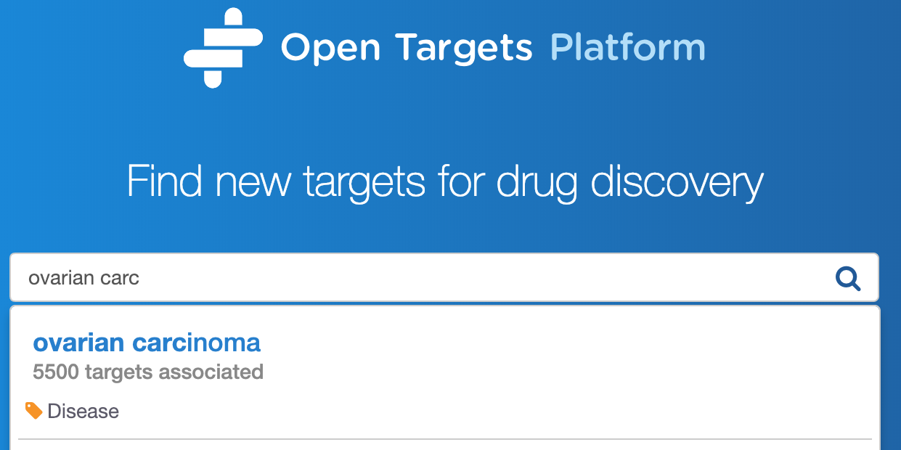
Live demo 1
Which targets are associated with my disease?
What is the evidence for the association?
Is there any data to help to prioritise the list of associated targets?
Coursebook: pages 8-16

Slide 18
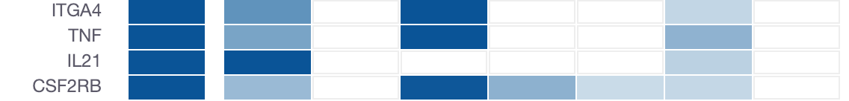
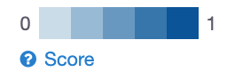
How well supported are the associations?
Association score to convey confidence
More evidence → stronger association score
Different evidence are scored and weighted in different ways
Overall score
Genetic
Somatic
Drugs
Pathways
Expression
Text mining
Animal mod

Slide 19
Evidence score → overall score
Statistical integration, aggregation and scoring
1) Evidence score (e.g. one SNP from a GWAS paper)
2) Data source score (e.g. all SNPs from the GWAS catalog)
3) Data type score (e.g. all sources of Genetic associations)
4) Overall association score
https://docs.targetvalidation.org/getting-started/scoring

Slide 20
Harmonic sum
Σ_{H}
*1.0
Genomics England
Score: 0 to 1 (max)
Σ_{H}
*1.0
PheWAS catalog
Σ_{H}
*1.0
European Variation Archive (germline)
Σ_{H}
*1.0
Σ_{H}
Genetic associations
Calculated at four levels:
Evidence
Data source
Data type
Overall
UniProt
Σ_{H}
*1.0
Gene2Phenotype
Σ_{H}
*1.0
GWAS catalog
Σ_{H}
*1.0
Cancer Gene Census
Σ_{H}
*1.0
European Variation Archive (somatic)
Σ_{H}
Somatic mutations
Σ_{H}
*1.0
IntOGen
Aggregation with (harmonic sum)
Σ_{H}
Σ_{H}
*1.0
ChEMBL
Drugs
Σ_{H}
*1.0
Reactome
Note: Each data set has its own scoring and ranking scheme
Σ_{H}
*0.5
SLAPenrich
Σ_{H}
*0.5
Σ_{H}
Pathways &
systems biology
PROGENy
Σ_{H}
*0.5
Sysbio
Σ_{H}
*0.2
Expression Atlas
RNA expression
Σ_{H}
*0.2
Europe PMC
Text mining
Σ_{H}
*0.2
PhenoDigm
Animal models
weight factor
Σ_{H}
S₁ + S₂/2² + S₃/3² + S₄/4² + S_{i}/i²
Σ_{H}
Association

Slide 21

Computing the evidence score
score = f * s * c
f, relative occurrence of a target-disease evidence
s, strength of the effect of the variant
c, confidence of the observation for the target-disease evidence
f = sample size (cases and controls)
s = predicted functional consequence (VEP)
c = p value reported in the paper
(Factors affecting the relative strength of GWAS Catalog evidence)

Slide 22
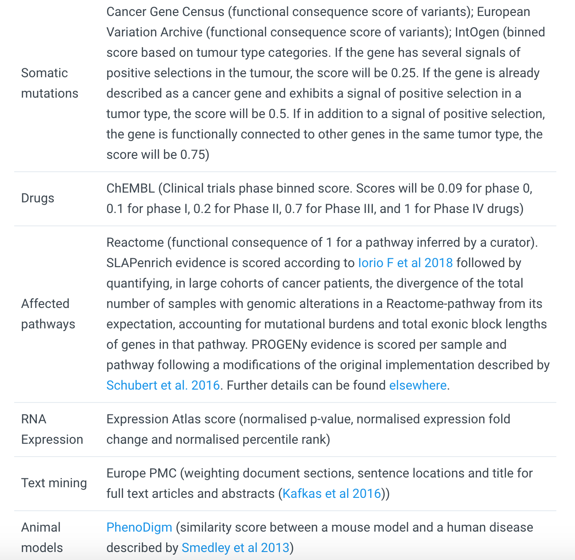
https://docs.targetvalidation.org/getting-started/scoring
Factors affecting the relative strength of the evidence

Slide 23
What can you do with the Open Targets Platform?
Target-disease associations (+ evidence + score)
https://www.targetvalidation.org/evidence/ENSG00000141510/EFO_0000228
Target annotations
https://www.targetvalidation.org/target/ENSG00000141510
Disease annotations
https://www.targetvalidation.org/diseaset/EFO_0000228

Slide 24
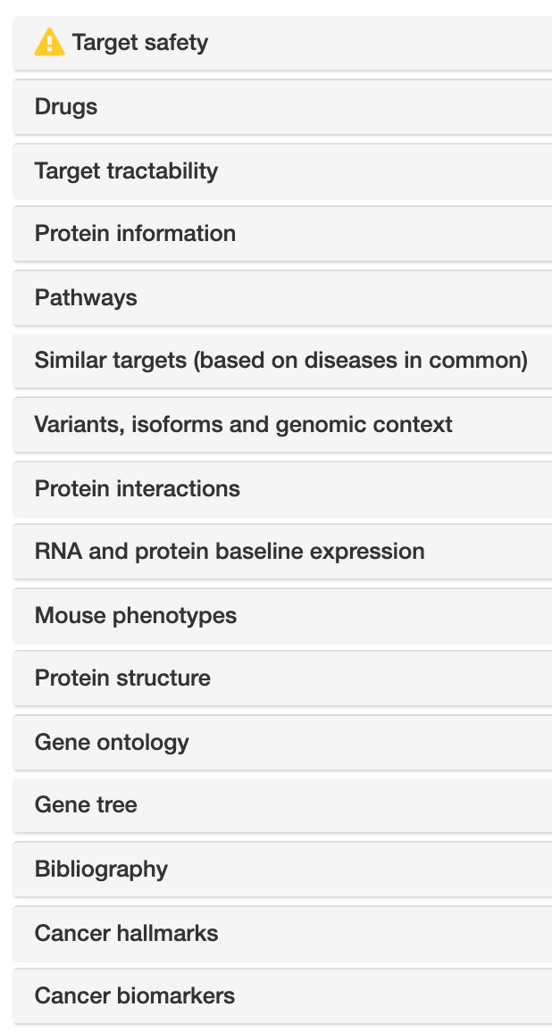
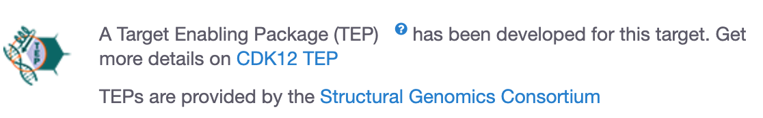
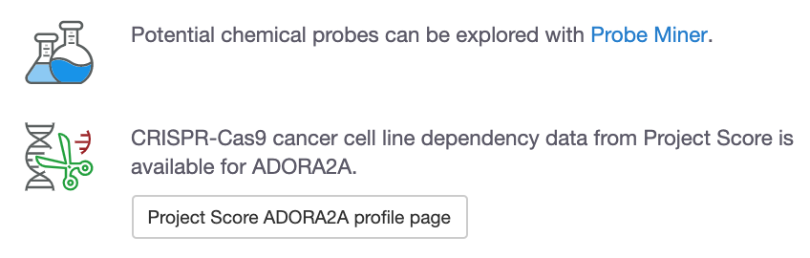
Target annotations
Target
profile page

Slide 25
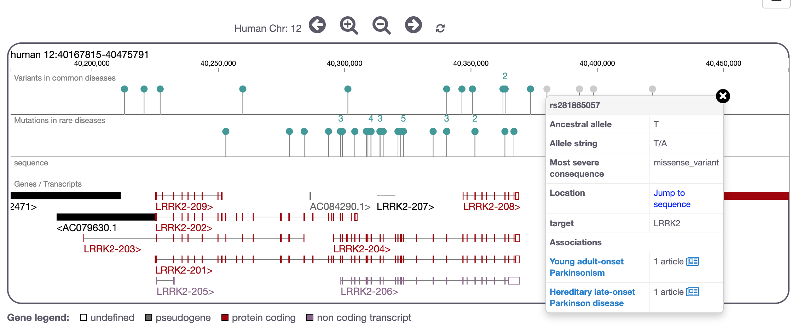
Does my target have disease-associated variants?

Slide 26
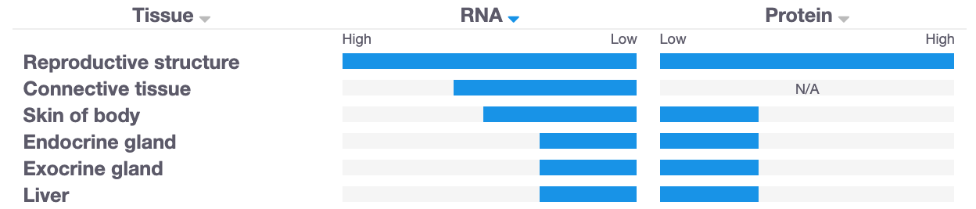
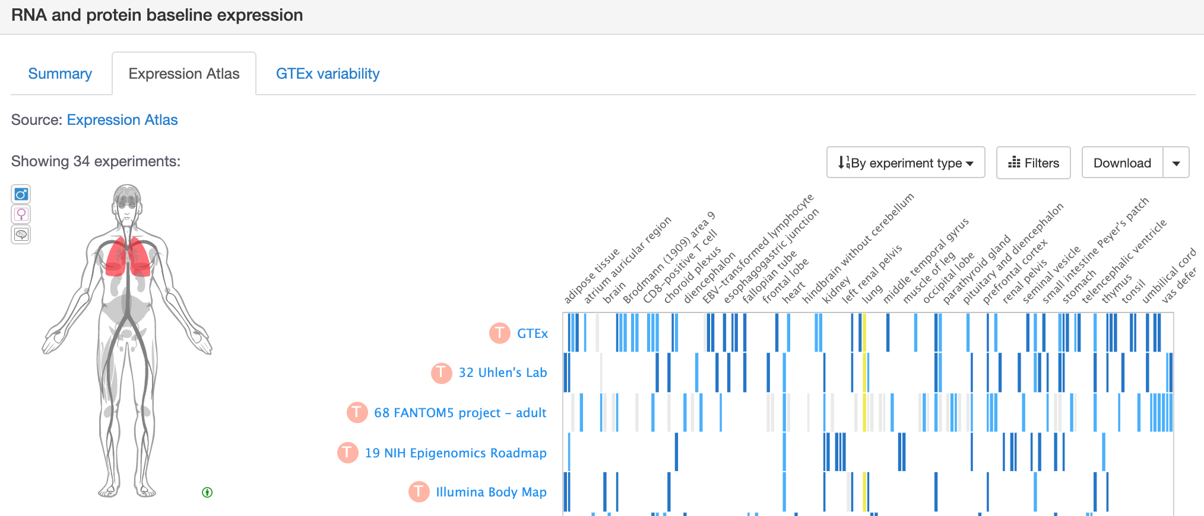
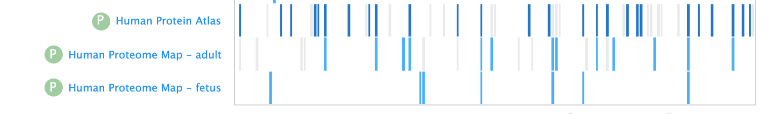
Is my target expressed in the relevant tissue?

Slide 27
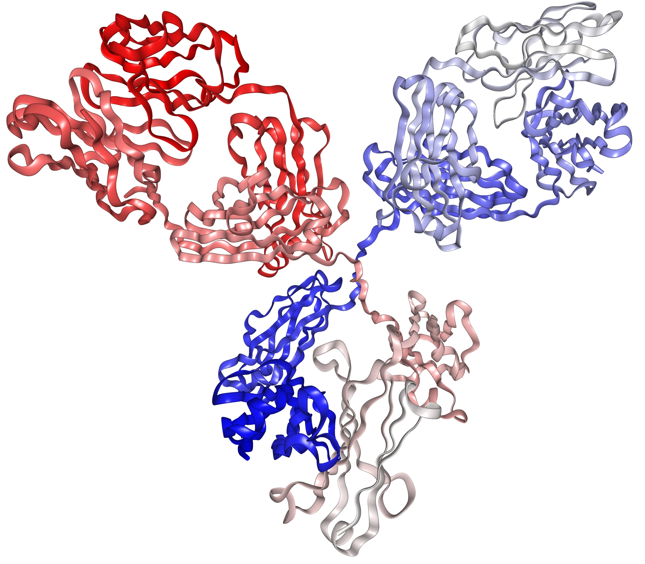
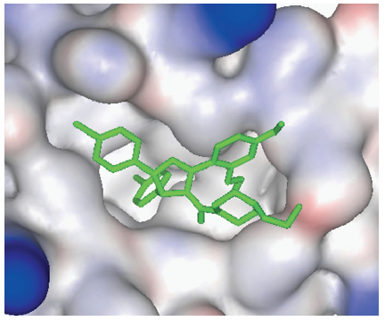
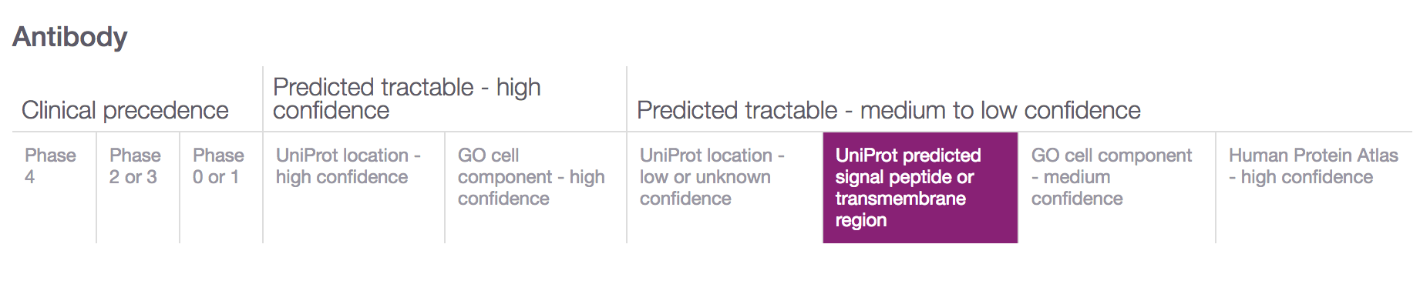
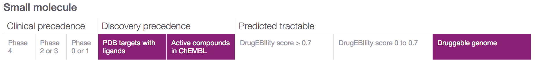
Is my target tractable?
DOI:10.1517/17460441.3.4.391
https://www.immunology.org/structure-antibody-1972

Slide 28
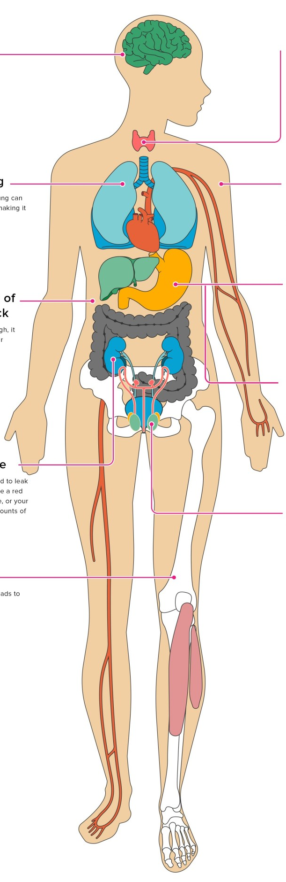
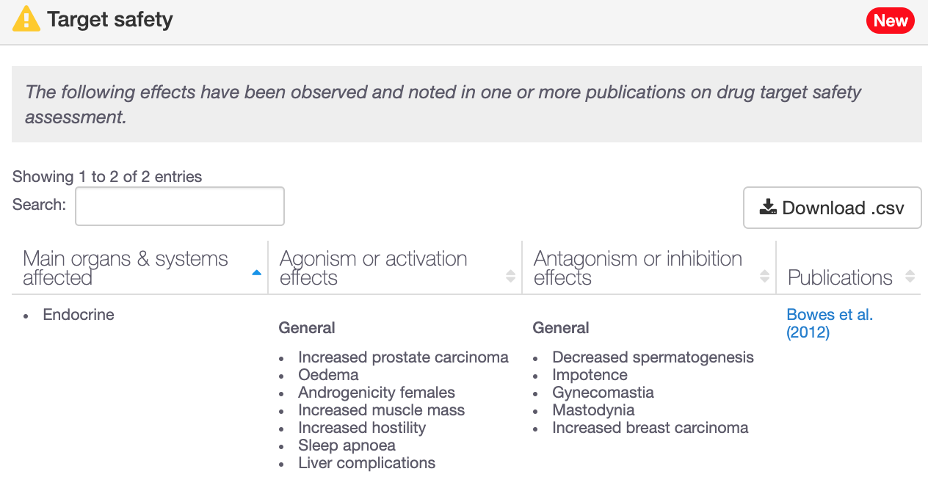
Is my target safe to be modulated?
193 genes with target safety information
Drowsiness
Increased heart rate
Hepatotoxicity

Slide 29
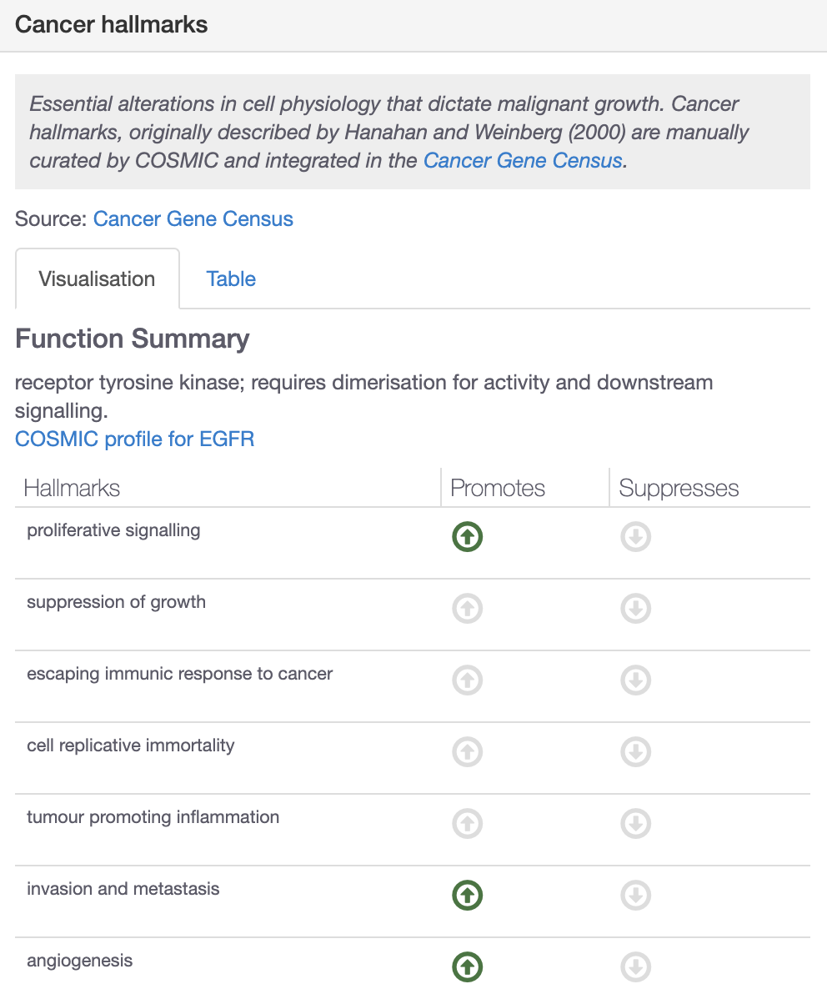
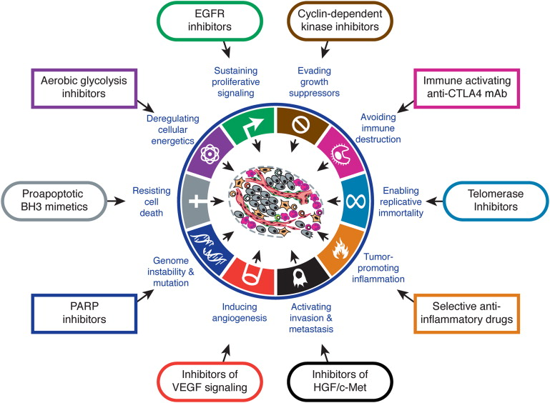
Hallmarks of cancer
https://www.targetvalidation.org/target/ENSG00000146648?view=sec:hallmarks
Hanahan and Weinberg (2000, 2011)

Slide 30
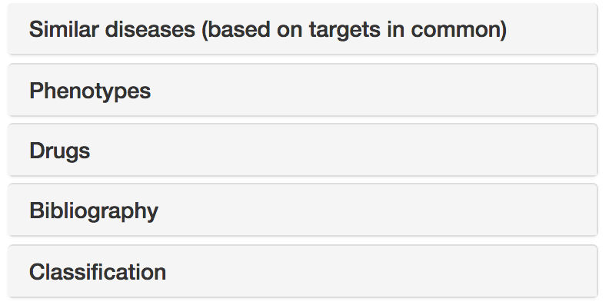




Disease annotations
Disease profile page
https://docs.targetvalidation.org/getting-started/getting-started/disease-profile

Slide 31
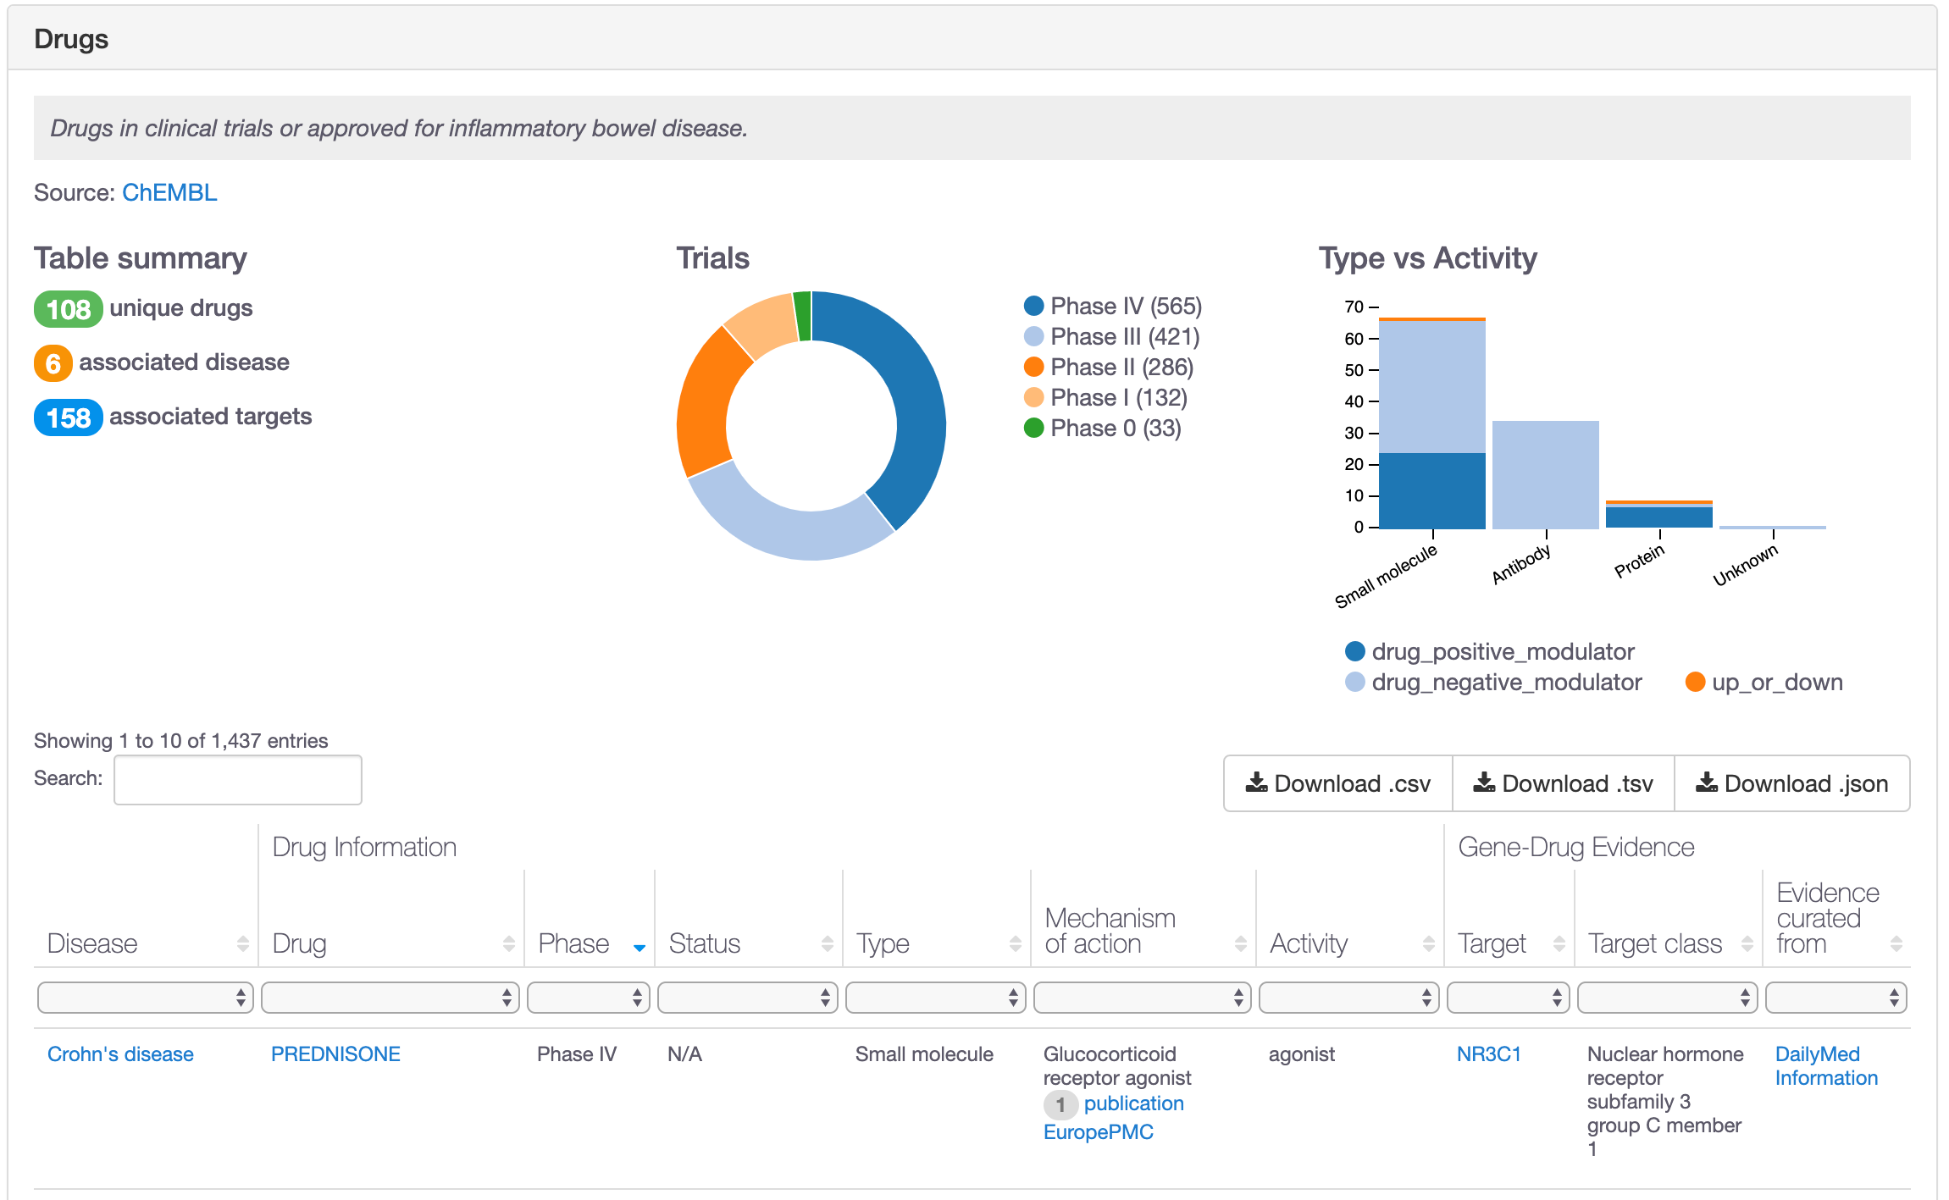
Which drugs are in clinical trials?

Slide 32
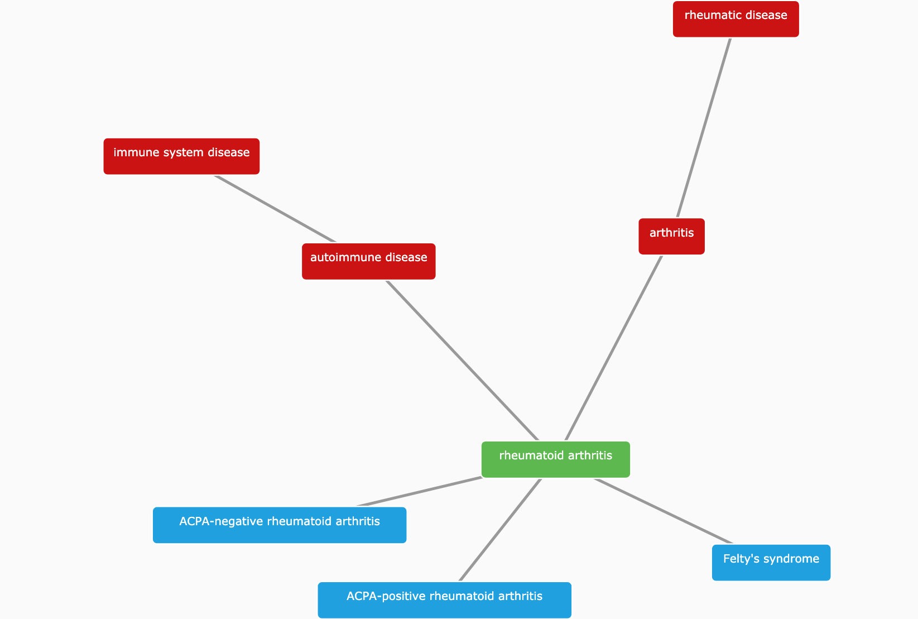
What is the relationship with other diseases?
https://www.targetvalidation.org/disease/EFO_0000685

Slide 33
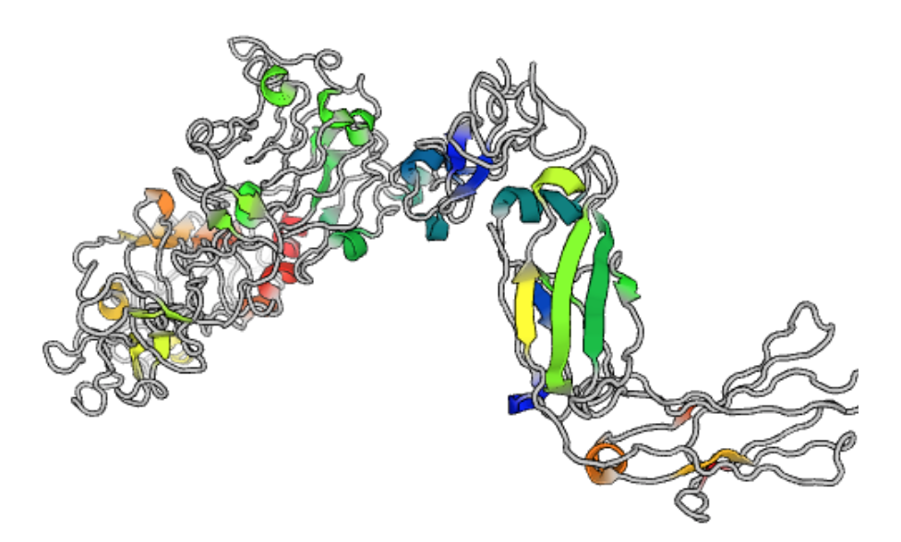
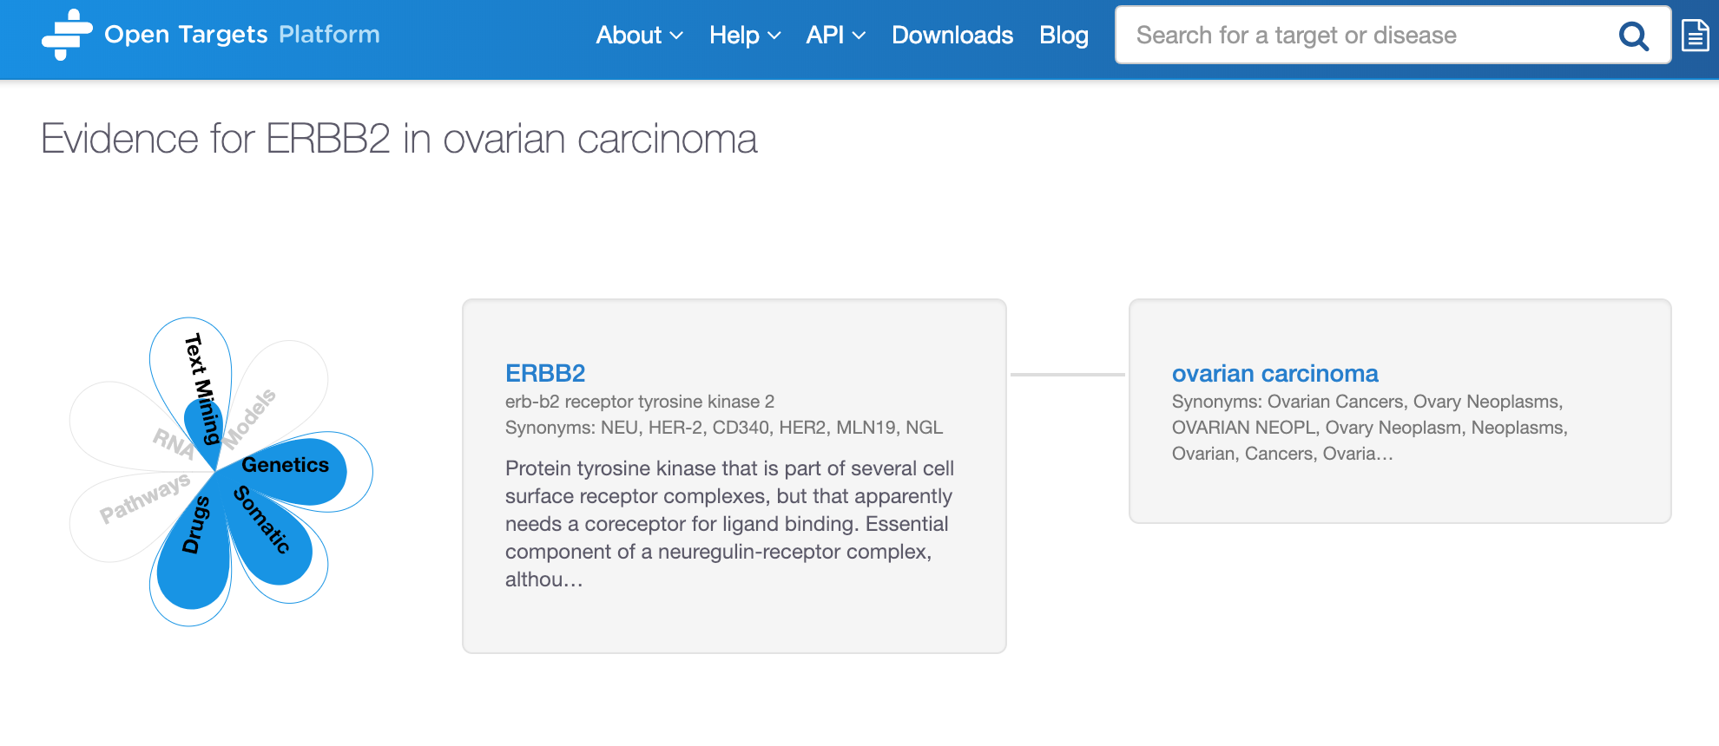
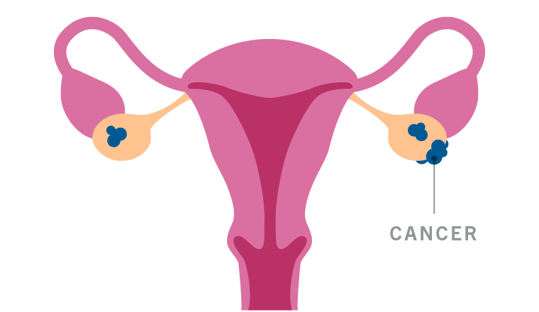
Demo 2
Target and disease annotations
Target
profile page
Disease profile page
Coursebook: pages 16-24

Slide 34
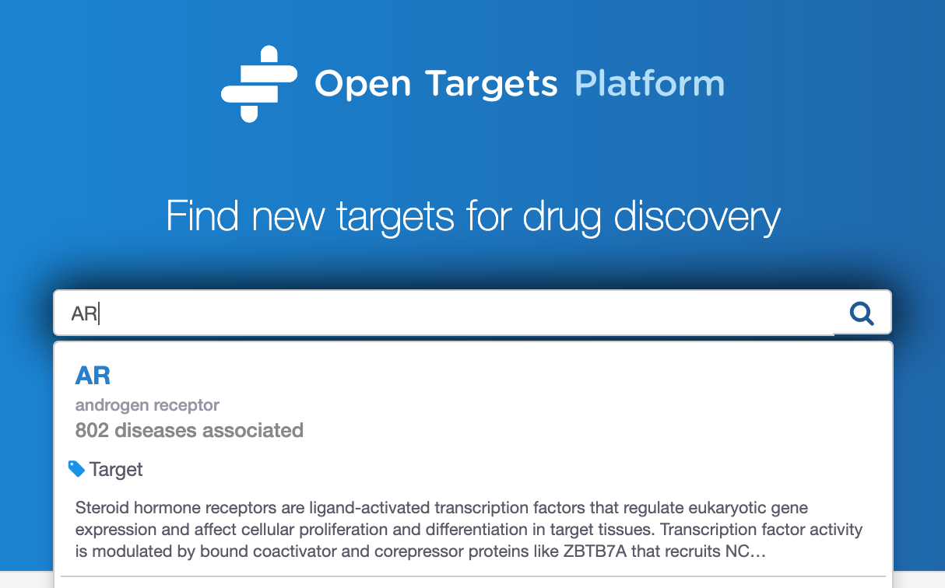
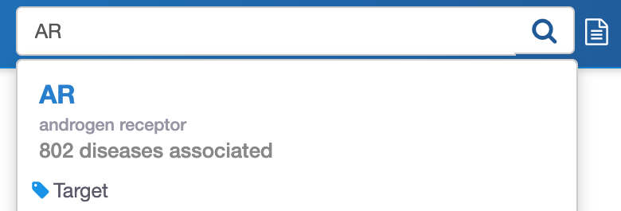
Demo 3
Searching for a target → diseases
Which diseases are associated with my target?
Coursebook: pages 24-27

Slide 35
Hands-on exercises
Durvalumab
Pancreatic carcinoma
Pages 28-30

Slide 36
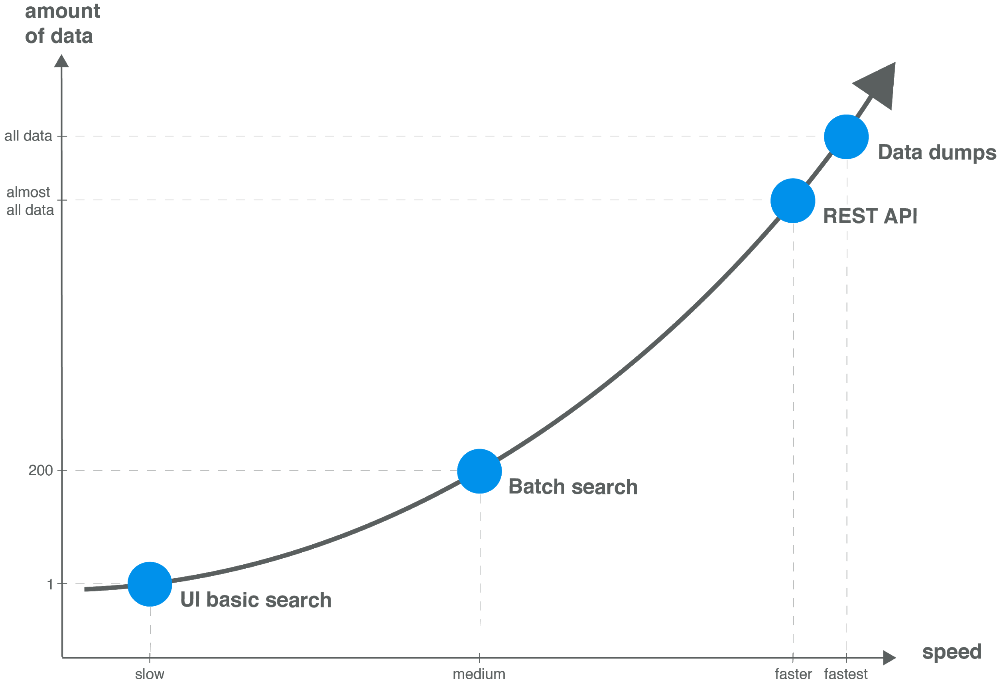
Modes of access → data volume
Notes:
Highlight the REST

Slide 37
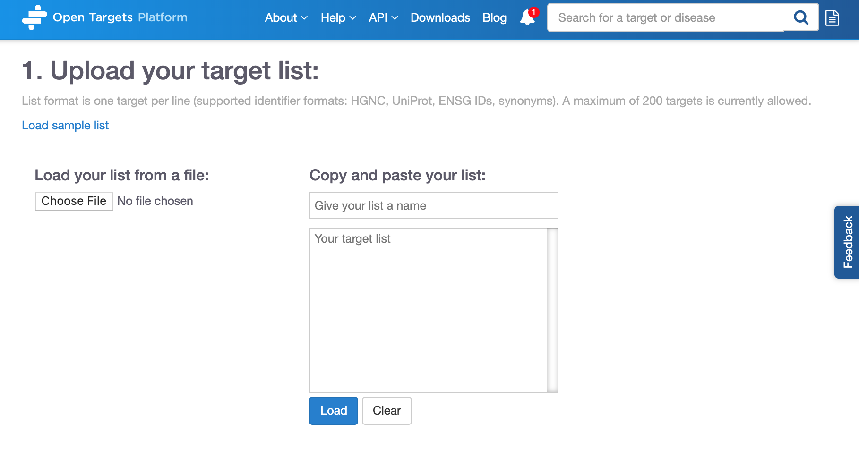
Batch search
https://www.targetvalidation.org/batch-search

Slide 38




Open Targets Platform REST API*
Server
https://platform-api.opentargets.io/v3/platform/
Endpoint
public/association/filter
Parameters
?target=ENSG00000163914&size=10000&fields=target.id&fields=disease.id
Open Targets Python client **
*
https://docs.targetvalidation.org/tutorials/rest-api
**
https://docs.targetvalidation.org/tutorials/python-client

Slide 39


Looking for the entire data?

Slide 40
Wrapping up
Public data
Experimental projects
Bioinformatics projects
DATA
GENERATION
DATA
INTEGRATION
Therapeutic hypothesis

Slide 41
Knowledge cycle
Public data
Experimental projects
Bioinformatics projects
DATA
GENERATION
DATA
INTEGRATION
Therapeutic hypothesis

Slide 42







Data generation: therapeutic areas
5 ongoing projects
7 ongoing projects
9 ongoing projects
3 complete projects
2 complete projects
2 publications
2 publications

Slide 43


Behan et al (2019)
Data now available in the Open Targets Platform e.g.
https://www.targetvalidation.org/evidence/ENSG00000100941/EFO_0000305?view=sec:affected_pathway
WRN sustains in vivo growth in:
colorectal
ovarian
endometrial
gastric
New candidate target for tumourss with MSI (WRN antagonists)

Slide 44




Connect with us
Open Targets Platform | Open Targets Genetics
docs.targetvalidation.org | genetics-docs.opentargets.org
support@targetvalidation.org | geneticsportal@opentargets.org
@targetvalidate
blog.opentargets.org/
http://tinyurl.com/opentargets-in
https://tinyurl.com/opentargets-youtube

Slide 45


Want to learn more?
http://bit.ly/cite-us

Slide 46

Looking for a career move?
https://www.opentargets.org/jobs

Slide 47



Thank you!

